Slide 1
Unit: Introduction of CG

Slide 2
Introduction:
Machine languages are the first generation of programming languages.
A machine language is a machine-dependent, low-level language that uses binary code to interact with a specific computer system.
A machine-dependent language works only on a specific computer system and its components.
A Machine Independent language is one that can run on any machine. An example of this would be Java.
Machine Independent language can take the compiled code for any given machine and run it on the machine we are attempting to run it on.
A TRULY machine-independent language would produce exactly the same output no matter which computer it was run on.

Slide 3
Open GL (Open Graphics Language)
OpenGL is a low-level graphics library specification.
It makes available to the programmer a small set of geometric primitives - points, lines, polygons, images, and bitmaps.
OpenGL provides a set of commands that allow the specification of geometric objects in two or three dimensions, using the provided primitives, together with commands that control how these objects are rendered (drawn).
Since OpenGL drawing commands are limited to those that generate simple geometric primitives (points, lines, and polygons), the OpenGL Utility Toolkit (GLUT) has been created to aid in the development of more complicated three-dimensional objects such as a sphere, a torus, and even a teapot.
GLUT may not be satisfactory for full-featured OpenGL applications, but it is a useful starting point for learning OpenGL.

Slide 4
Libraries
OpenGL provides a powerful but primitive set of rendering command, and all higher-level drawing must be done in terms of these commands.
There are several libraries that allow you to simplify your programming tasks, including the following:
OpenGL Utility Library (GLU) contains several routines that use lower-level OpenGL commands to perform such tasks:
as setting up matrices for specific viewing orientations and projections and rendering surfaces.
OpenGL Utility Toolkit (GLUT) is a window-system-independent toolkit, written by Mark Kilgard, to hide the complexities of differing window APIs

Slide 5
Graphics Software
Graphics software refers to a program or collection of programs that enable a person to manipulate images or models visually on a computer.
There are two general classifications for graphical Software's.
a. General Programming Packages:
General programming packages provides an extensive set of graphics functions that can be used in a high-level programming language, such as C or FORTRAN. E.g. GL (Graphics Library) system on Silicon Graphics equipment

Slide 6
b. Special Purpose Application Packages:
Special purpose applications packages are, in contrast designed for non programmers, so that users can generate displays without worrying about how graphics operations work.
The interface to the graphics routines in such packages allows users to communicate with the programs in their own terms.
For example: the artist’s painting programs and various business, medical, and Computer-Aided Design (CAD) systems.

Slide 7
There are many graphics software available in market; they can be categories as:
Paint program: Paint program works with bit map images.
Photo manipulation program: It works with bit map images and is widely used to edit digitized photographs.
Computer Aided Design program: CAD software is used in technical design fields to create models of objects that will be built or manufactured.
3-D Modeling Programs: It is used to create visual effects. 3-D modeling program works by creating objects like surface, solid, polygon etc.
Animation: Computer are used to create animation for use in various fields, including games, and movies composing to allow game

Slide 8
Color Models
"Color model is a 3D color coordinate system to produce all range of color through the primary color set." There are millions of colors used in computer graphics.
The light displays the color. A Color model is a hierarchical system in which we can create every color by using RGB (Red, Green, Blue) and CMYK (Cyan, Magenta, Yellow, Black) models.
We can use different colors for various purposes.
The total number of colors displayed by the monitor depends on the storage capacity of the video controller card.
The Video controller card is used as an interface between the computer system and the display device. It is also known as “Video Random Access Memory (VRAM).”

Slide 9
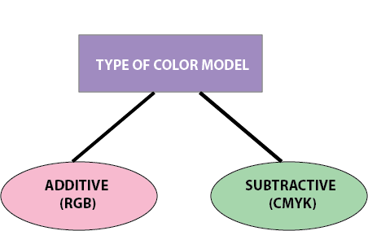

Slide 10
Additive Color Model:
It is also named as “RGB model.” RGB stands for Red, Green, Blue.
The Additive color model uses a mixture of light to display colors.
The perceived color depends on the transmission of light.
It is used in digital media.
For Example: Computer Monitor, Television etc.

Slide 11
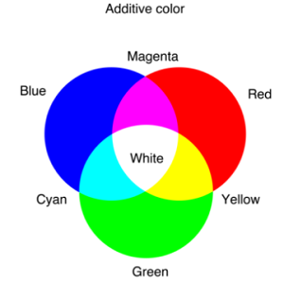

Slide 12
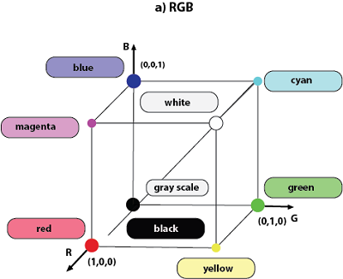

Slide 13
Subtractive Model
It is also named as “CMYK Model.” CMYK stands for Cyan, Magenta, Yellow, and Black.
The Subtractive model uses a reflection of light to display the colors.
The perceived color depends on the reflection of light.
The CMYK model uses printing inks.
For Example- Paint, Pigments, and color filter etc.

Slide 14
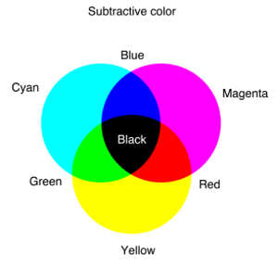

Slide 15
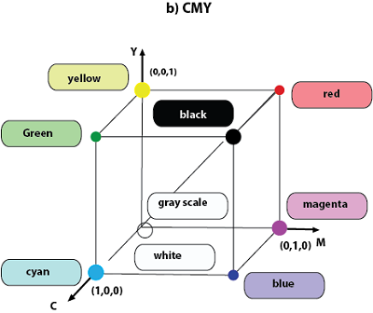

Slide 16
Assignment:
1.HSV Color Model

